Slide 1
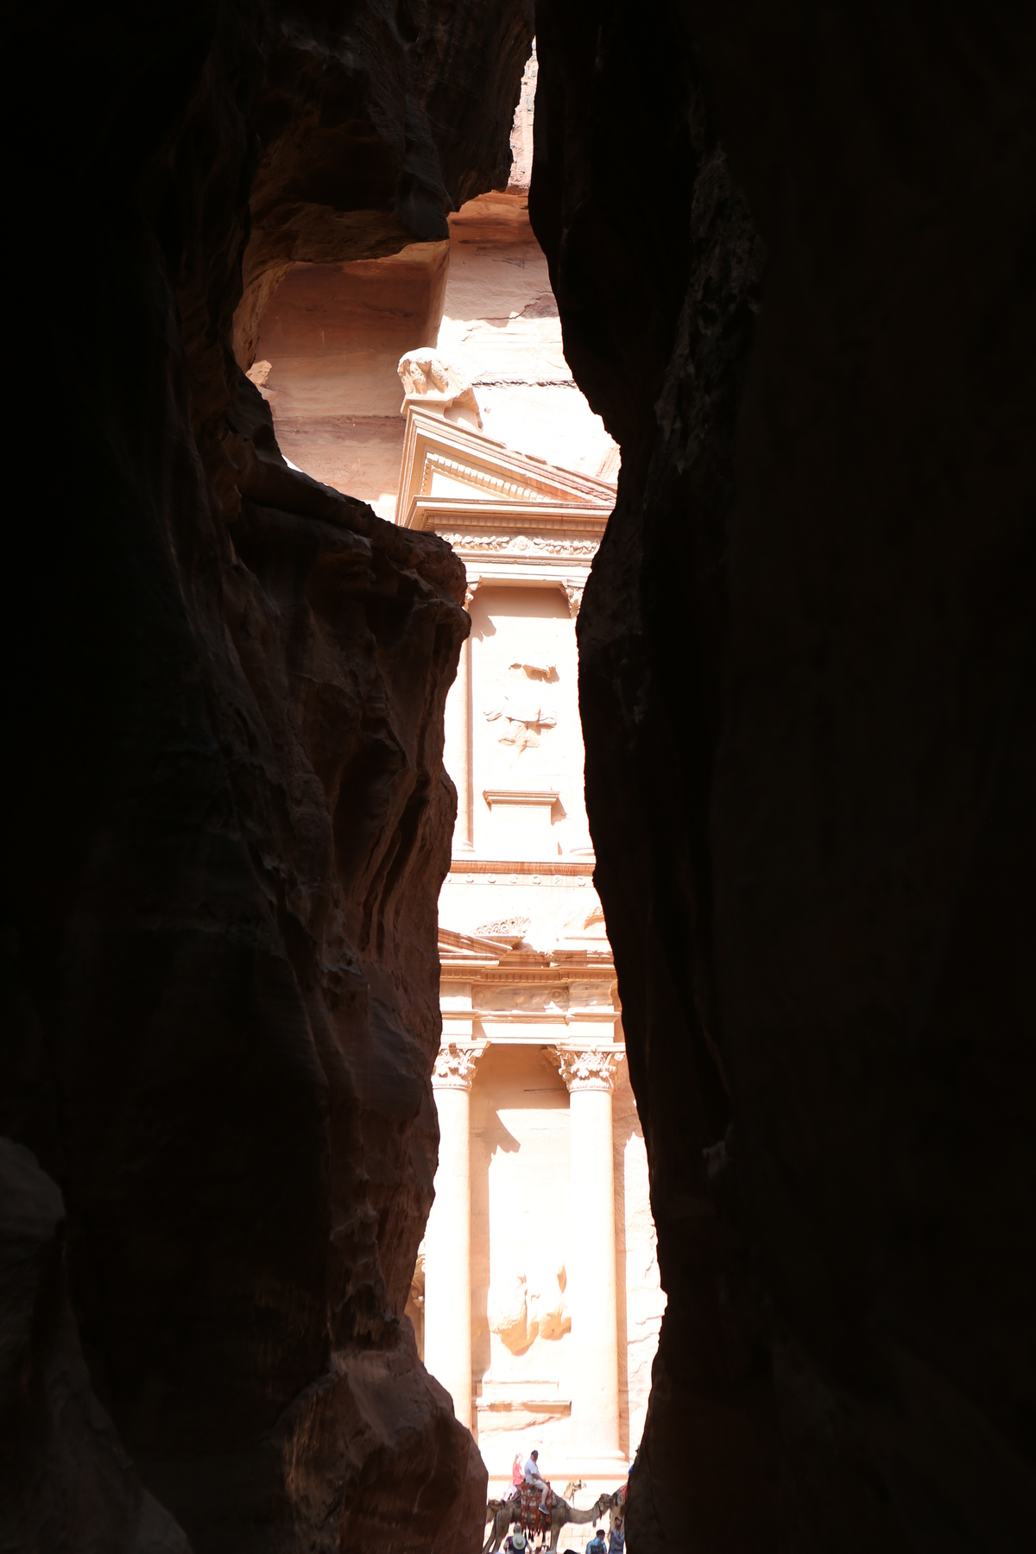
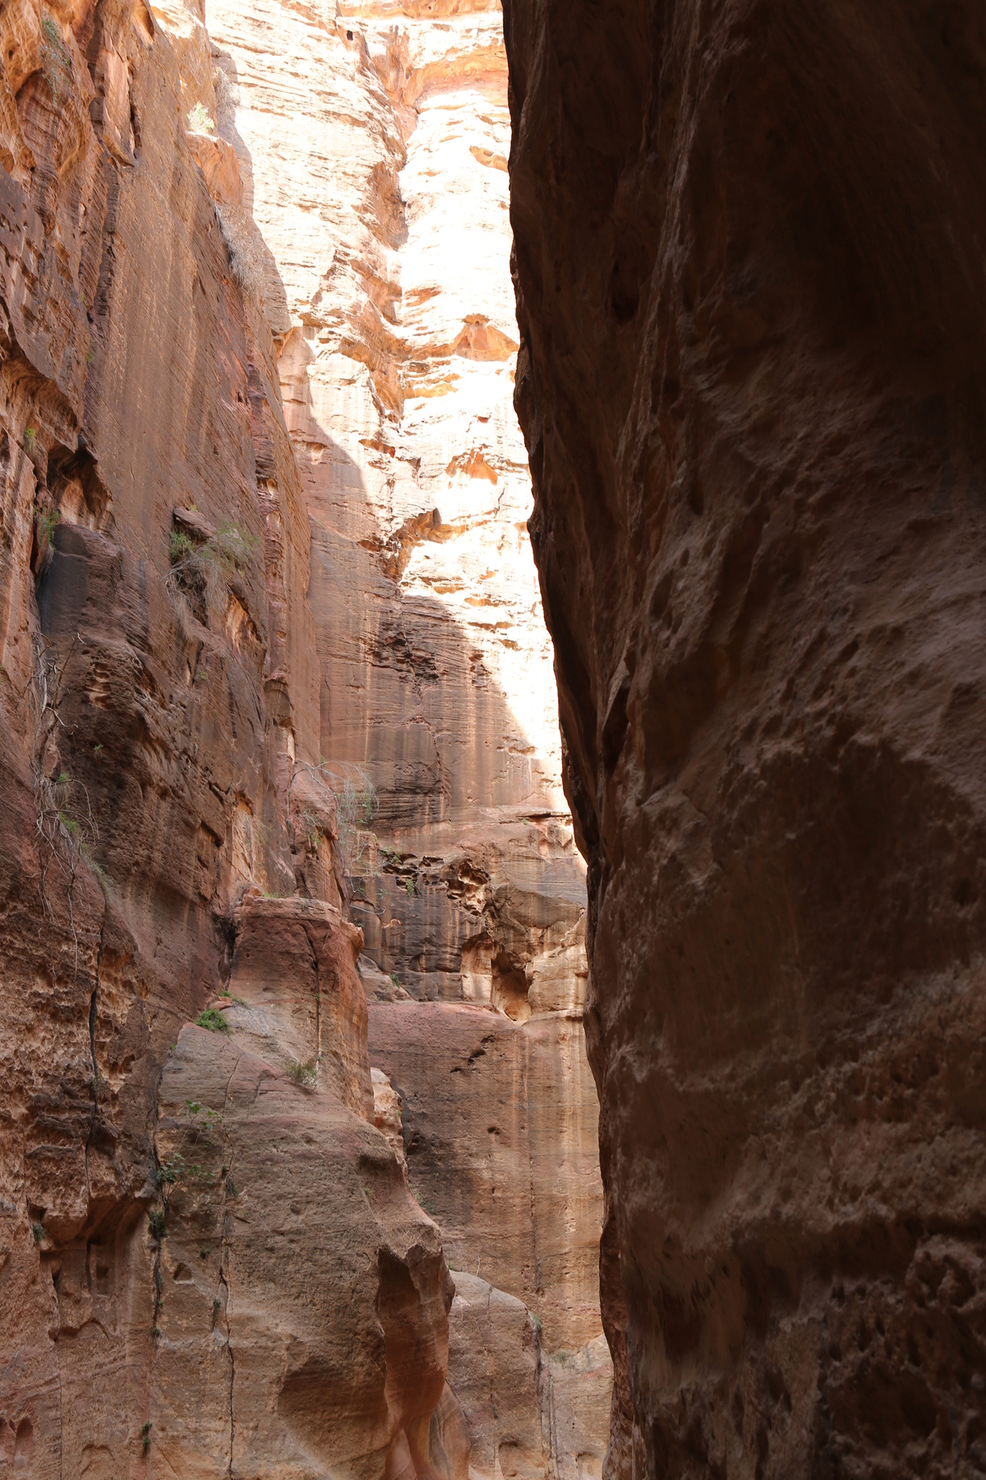
Petra

Slide 2
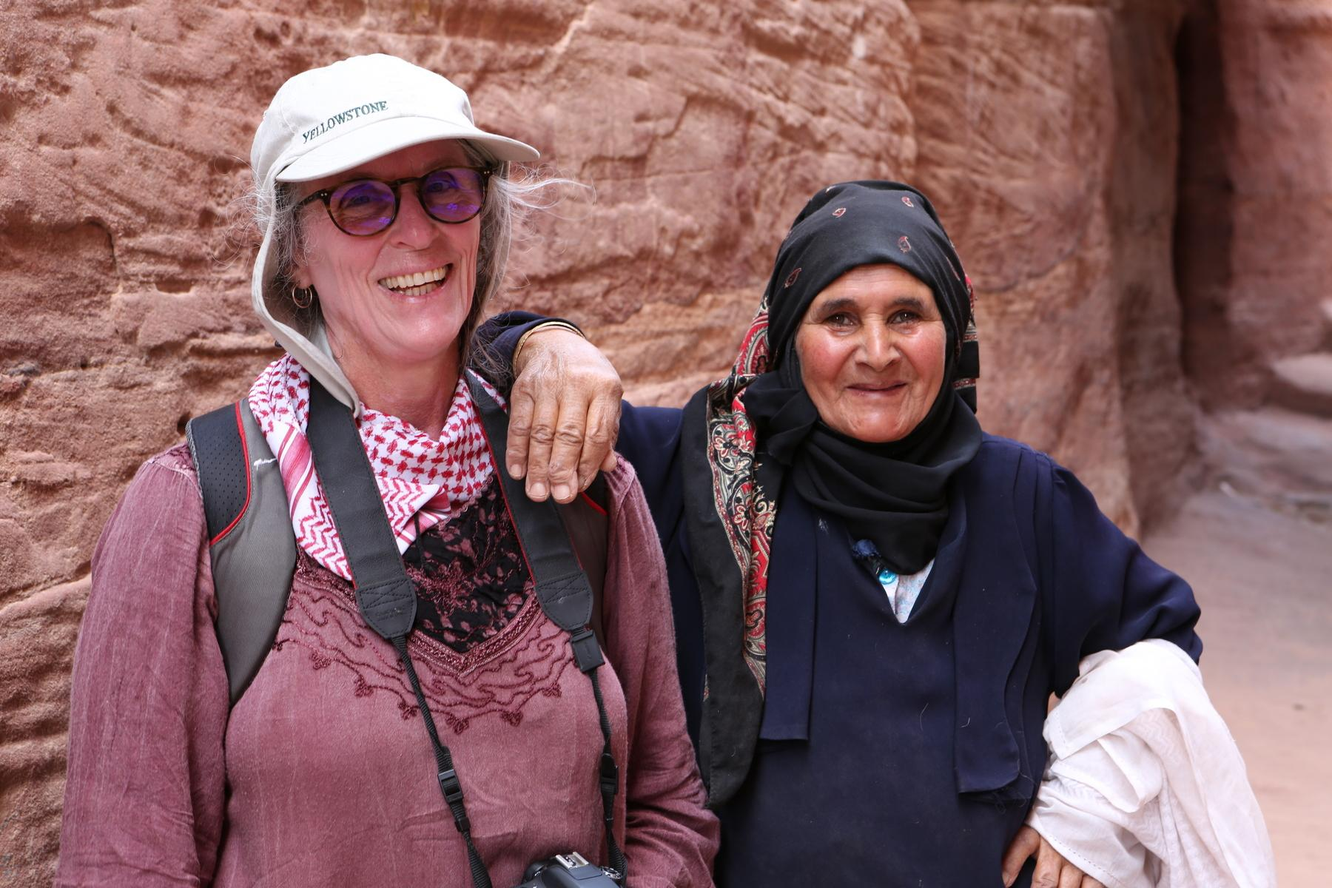

Slide 3
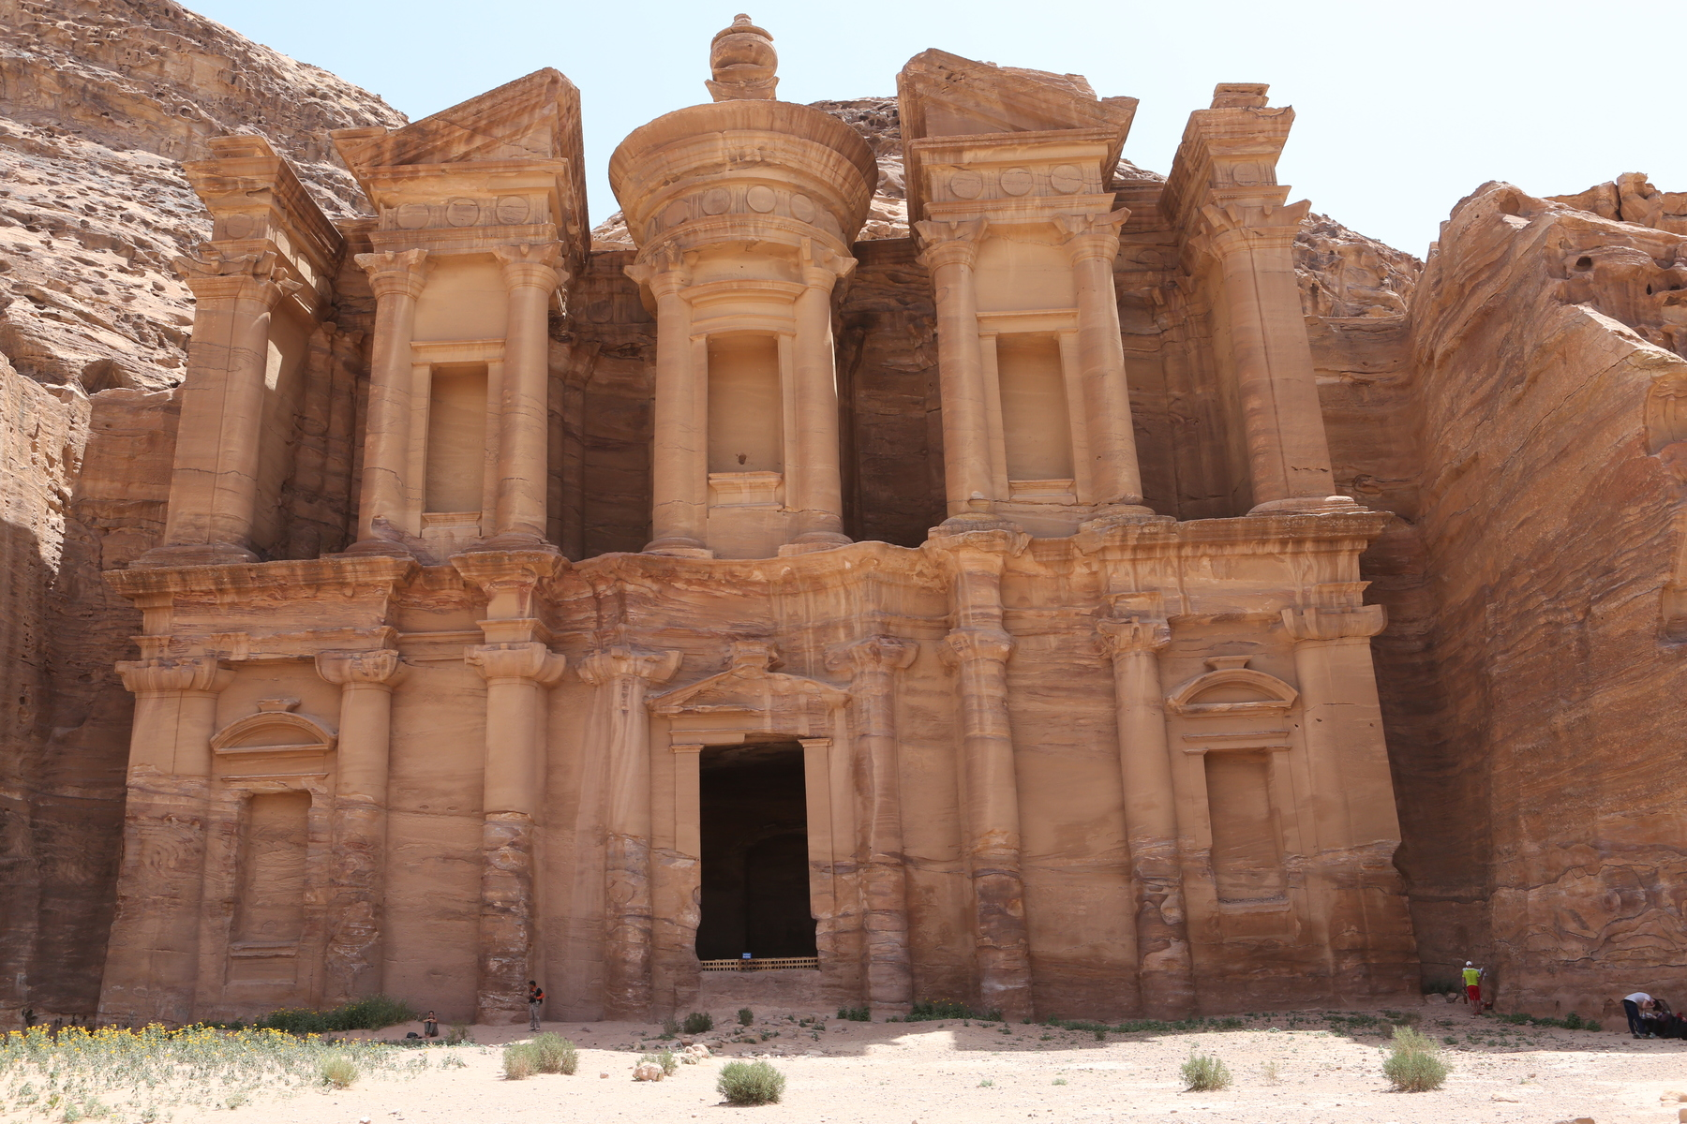

Slide 4
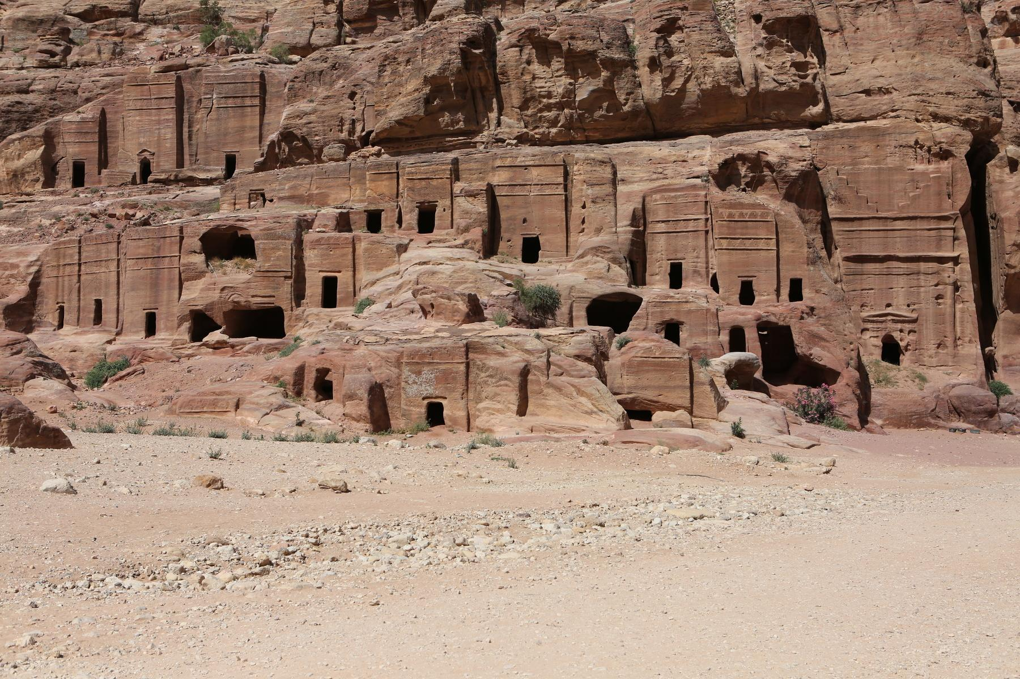

Slide 5
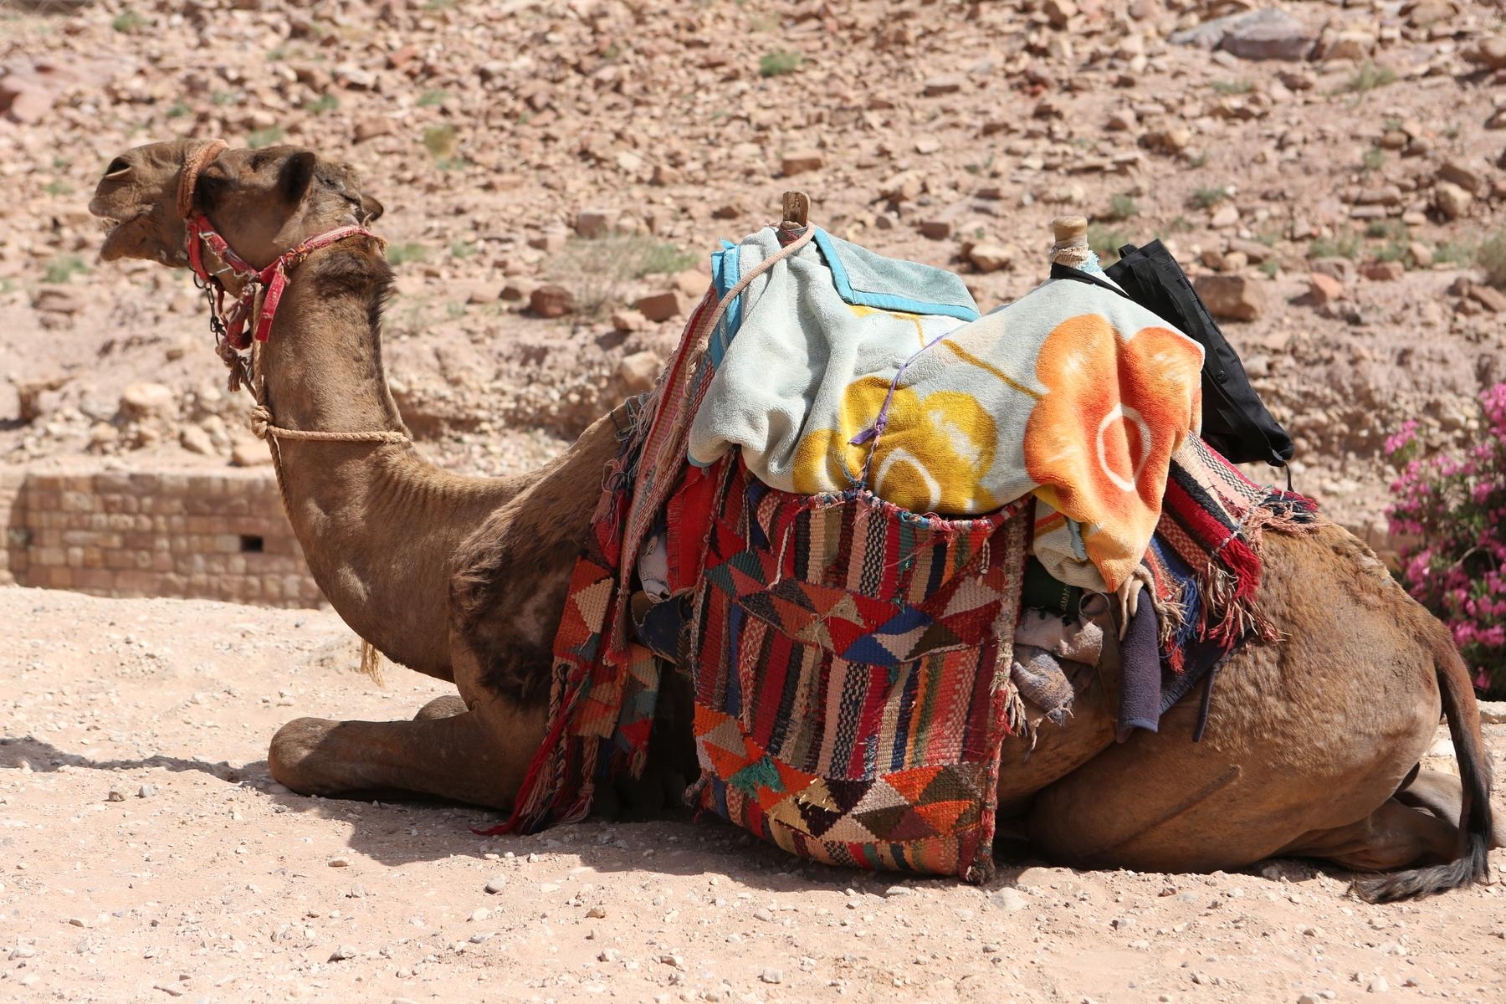

Slide 6
We still do not have additional Ethernet Card
We can work on Virtual Machines using the 172.16.9.X addresses
Proposed temporary additiions to /etc/hosts:
172.,16.9.193 htc-puppet.najah.edu htc-puppet
172.,16.9.194 htc-cobbler.najah.edu htc-cobbler
172.,16.9.195 htc-htcondor.najah.edu htc-htcondor
172.,16.9.196 www-htc.najah.edu www-htc
172.16.9.197 others???
Items to work on:
Automounting home directories - https://www.centos.org/docs/5/html/Deployment_Guide-en-US/s1-nfs-client-config-autofs.html
User quotas - Home directories Data area - https://www.centos.org/docs/5/html/Deployment_Guide-en-US/ch-disk-quotas.html
HTCondor - Master Virtual Machine
Cobbler
Puppet - Infrastructure It will be a lot of work to chnage certificates

Slide 7

For next time or time after that:
Generating a movie using ray tracing
Generating a fractal zoom
Other CPU intensive project of your choice.
In mathematics, a fractal is an abstract object used to describe and simulate naturally occurring objects. Artificially created fractals commonly exhibit similar patterns at increasingly small scales. It is also known as expanding symmetry or evolving symmetry. If the replication is exactly the same at every scale, it is called a self-similar pattern.

Slide 8


Slide 9


